Slide 1
Extraction of dynamic data from an Aadhar Card
Under the Guidance of : Kunal Shriwas(Data Scientist)
Submitted By : Archana

Slide 2
Index
Introduction
Problem statement
Existing System
Gaps in Existing System
Objective
Requirements
Method
Algorithm
Applications
Result
Conclusion
References

Slide 3
Introduction
The current project is one of the emerging and future useful software.Here we are taking specially Aadhar card as input card.The resulting output will be the extracted Data from Aadhar card.
The extracted data contains name, Date of Birth, Gender and Aadhar number. For building the software we are using mainly machine learning techniques like superimposition, text extracting tools, text cleaning tools etc.
The project will be useful for our future especially in Government sector where instead of entering the data by manually by seeing the card we use this system which will take input card and within seconds gives output.

Slide 4
Problem Statement
By inserting an Aadhar card into the software , the resultant output will be required extracted data.
The extracted data contain name, father name, Date of Birth and Aadhar number of an individual to whom the card belongs to.

Slide 5
Existing system
Currently we are entering the data from the Aadhar card by manually seeing it and entering it in a computer.
this traditional method is going on in every Government sectors and education systems.
the traditional method is useful enough when there are limited number of inputs.
For large number of inputs it is heavy.
And mostly while entering the data the person requires hardcopy of the card.

Slide 6
Gaps in Existing system
Existing system is traditional one which will take more time compared to the current software.
The method is useful when there are small number of inputs.
For large inputs it will be heavy.
Sometimes while entering the data mistakes may occur.

Slide 7
Objective
The main goal of the project is to extract the following data from the input Aadhar card within time and correct accuracy.
1. Name
2. Date of Birth
3. Gender
4. Aadhar number

Slide 8
Requirements
Software requirements:
Python
Open CV
Pytesseract
Regex
Hardware requirements:
Windows OS
X86 64-bit CPU
4 GB RAM
5 GB free disk space

Slide 9
Method
The method involves the steps like
Data preparation
1. Dummy text generation
2. Blank template generation
3. Superimposing the image on the template
4. Embedding the text on the template.
Loading the input card
Conversion to gray scale image (Optional)
Text extraction
Text cleaning

Slide 10
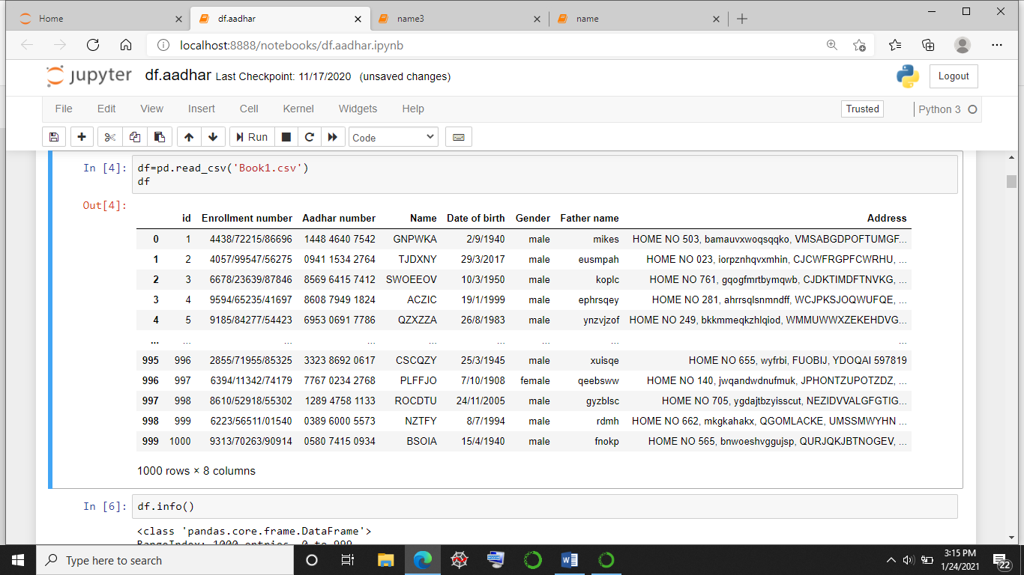
Data frame

Slide 11
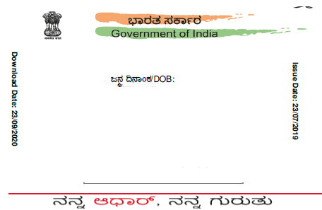
Blank template

Slide 12
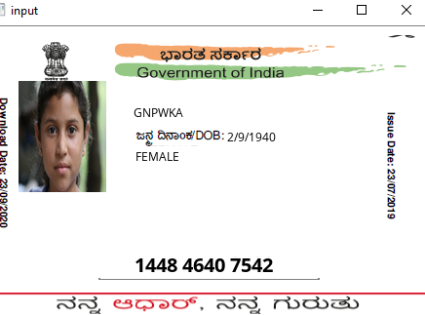
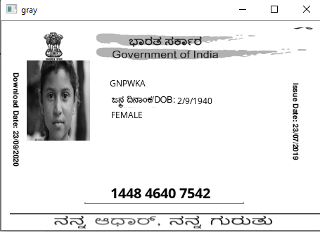


Slide 13
Algorithm
Step 1. Generate the names, date of births, gender and Aadhar numbers randomly by importing Random in python.
Step 2. Generate a CSV file using all the generated data.
Step 3. Convert the CSV file into data frame.
Step 4. Create a Blank template and insert the image file and data frame into the template.
Step 5. Apply OCR technique loading the card and text extraction.
Step 6. Use regular expression for text cleaning.
Step 7. The remaining text is required output.

Slide 14
Applications
The current software will be applied in the following criteria or regions.
Banking Sector
Education System
Business area
Government sector

Slide 15
Result
The current projects will results as a software which will help in reducing the human work.
This current project is giving approx. 80% result .i.e it is successfully working 80%.
some of the drawbacks are like for some images it is not giving exact output.
We ensure that if we will get exact results further. As this is using machine learning technologies it will give the optimal results as possible.

Slide 16
Conclusion
Now we conclude that after applying all the required Machine learning techniques on Aadhaar card. And we got the required result. The resulting card reader system is helpful for the human beings to reduce the work. And it is helpful in all the sectors such as banking system, education field etc.
As like in every field there will be a verification process where we will take the identity proof and for verification we add the details from the card. For creating this card reader system we can apply other OCR techniques also.

Slide 17
References
Extraction Of Aadhar IDs Using OpenCV & TensorFlow- Sushil ...
dilippuri/Aadhaar-Card-OCR: Extract text information ... – GitHub
Aadhaar Generation - Unique Identification Authority of India ...

Slide 18
Any queries?

Slide 19
Thank you

